Slide 1

Partial order, Lattice Structure and Distributed Computation
a brief introduction
Yu Huang
http://cs.nju.edu.cn/yuhuang

Slide 2
Modeling of System Behavior
Space-time diagram (STD)
Meaningful snapshots of a distributed system
Lattice of snapshots
Lattice as a partial order set
Lattice as all possible evolutions of system state
Lattice as a directed acyclic graph (DAG)
Lattice as an algebraic structure of snapshots
Relation between the STD and the lattice
Birkhoff’s representation theorem

Slide 3
Space-Time Diagram (STD)
An intuitive illustration of the distributed computation
s⁽¹⁾₀
e⁽¹⁾₁
s⁽¹⁾₁
e⁽¹⁾₂
s⁽¹⁾₂
e⁽¹⁾₃
s⁽¹⁾₃
e⁽¹⁾₄
s⁽¹⁾₄
P⁽¹⁾
P⁽²⁾
s⁽²⁾₀
e⁽²⁾₁
s⁽²⁾₁
e⁽²⁾₂
s⁽²⁾₂
e⁽²⁾₃
s⁽²⁾₃
e⁽²⁾₄
s⁽²⁾₄
time
Notes:
Distributed, asynchronous

Slide 4

Linear Extension
A total order of events [Schwarz@DC’94]
e⁽¹⁾₁
e⁽²⁾₁
e⁽²⁾₂
e⁽¹⁾₂
e⁽²⁾₃
e⁽¹⁾₃
e⁽¹⁾₄
e⁽²⁾₄
e⁽¹⁾₁
e⁽¹⁾₂
e⁽¹⁾₃
e⁽¹⁾₄
P⁽¹⁾
P⁽²⁾
e⁽²⁾₁
e⁽²⁾₂
e⁽²⁾₃
e⁽²⁾₄
time
e⁽¹⁾₁
e⁽²⁾₁
e⁽¹⁾₂
e⁽²⁾₂
e⁽¹⁾₃
e⁽²⁾₃
e⁽²⁾₄
e⁽¹⁾₄

Slide 5
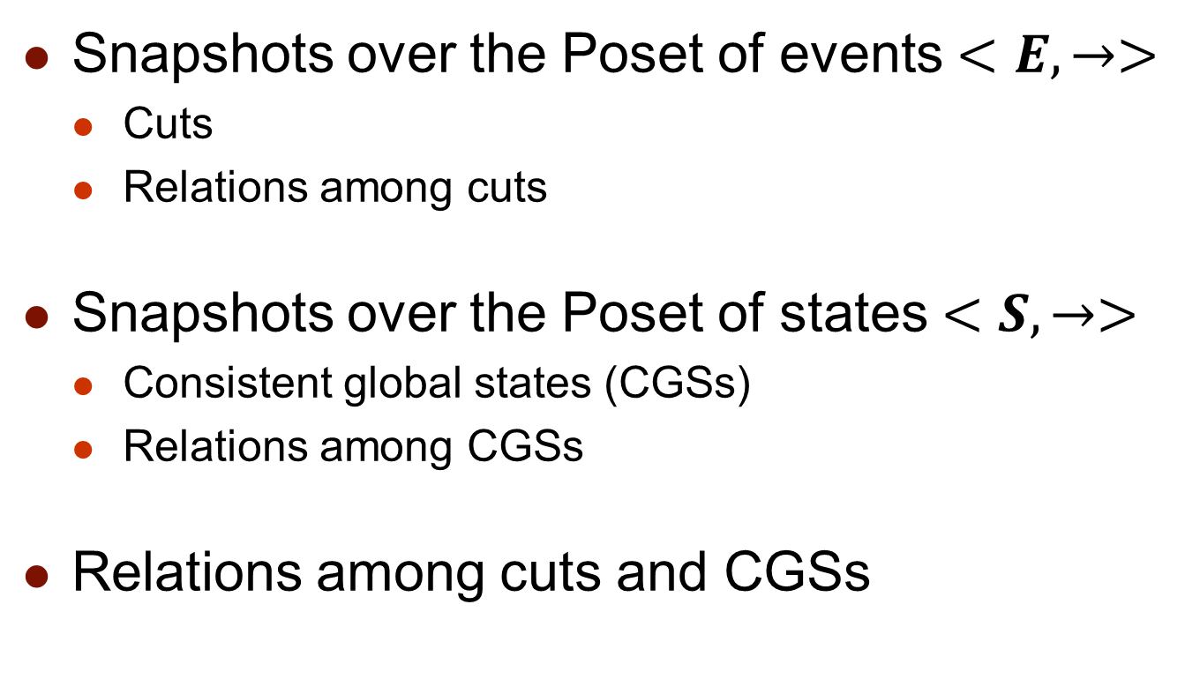
Meaningful Snapshots
Snapshots over the Poset of events $<E,→>$
Cuts
Relations among cuts
Snapshots over the Poset of states $<S,→>$
Consistent global states (CGSs)
Relations among CGSs
Relations among cuts and CGSs
Notes:
Here cut means consistent cut.

Slide 6



Cut
Snapshots over the trace of events
Distributed computation: $<E, →>$
Cut [Schwarz@DC’94]
e⁽¹⁾₁
e⁽¹⁾₂
e⁽¹⁾₃
e⁽¹⁾₄
P⁽¹⁾
P⁽²⁾
e⁽²⁾₁
e⁽²⁾₂
e⁽²⁾₃
e⁽²⁾₄
time

Slide 7

Definition of Cut
A down set with the happen-before relation
Definition [Schwarz@DC’94]
A finite subset $C$ of $E$ is a consistent cut iff
$e∈C$ implies that $∀e^{′}→e, e′∈C$

Slide 8








Relations among Cuts
The inclusion ($⊆$) partial relation
The inf ($⨅$) and sup ($⨆$) relation [Gratzer’03, Mittal@DC’05]
Interval of cuts [Chase@DC’98, Dumais@TPDS’02]
$$C_{1}$$
$$[C_{1},C_{2}]$$
$$C_{3}$$
$$C_{2}$$
e⁽¹⁾₁
e⁽¹⁾₂
e⁽¹⁾₃
e⁽¹⁾₄
P⁽¹⁾
P⁽²⁾
e⁽²⁾₁
e⁽²⁾₂
e⁽²⁾₃
e⁽²⁾₄
time
$$Inf(C_{2},C_{3})$$
$$sup(C_{2},C_{3})$$
$$C_{1}⊆C_{2}$$
Notes:
Partial relation
Two CGSs are not contained by each other. The graph representation is natural. On mathematical view, inf and sup are their meet and join, respectively.

Slide 9

Consistent Global State
Snapshots over the trace of local states
Distributed computation: $<S, →>$
Consistent global state (CGS) [Babaoglu@DS’93]
s⁽¹⁾₀
s⁽¹⁾₁
s⁽¹⁾₂
s⁽¹⁾₃
s⁽¹⁾₄
P⁽¹⁾
P⁽²⁾
s⁽²⁾₀
s⁽²⁾₁
s⁽²⁾₂
s⁽²⁾₃
s⁽²⁾₄
time
Notes:
CGS over the graph representation (space-time diagram) is the maximal anti-chain over the Poset.

Slide 10

Definition of CGS
Definition
A global state $C=(s^{(1)},s^{(2)}, …,s^{(n)})$ is a consistent global state iff
$$∀i,j:i≠j∷¬(s^{(i)}→s^{(j)})$$

Slide 11








Relations among CGSs
The precede ($≺$) partial relation
The lead-to ($⇝$) relation [Babaoglu@JPDC’95]
The inf ($⨅$)and sup ($⨆$) relation[Mattern@WPDA’89]
$$C_{1}⇝C_{3}$$
$$C_{1}≺C_{2}$$
s⁽¹⁾₀
s⁽¹⁾₁
s⁽¹⁾₂
s⁽¹⁾₃
s⁽¹⁾₄
P⁽¹⁾
$$Inf(C_{2},C_{3})$$
$$sup(C_{2},C_{3})$$
P⁽²⁾
s⁽²⁾₀
s⁽²⁾₁
s⁽²⁾₂
s⁽²⁾₃
s⁽²⁾₄
time
$$C_{3}$$
$$C_{1}$$
$$C_{2}$$
Notes:
Partial relation

Slide 12

Cuts and CGSs
$<C_{E}, ⊆>$ and $<C_{S}, ⇝>$ are isomorphic
$f:C_{E}→C_{S}$ is an isomorphism
$f$ is a bijection
$C_{1}⊆C_{2}$, iff $f(C_{1})⇝f(C_{2})$
[Babaoglu@DS’93, Gratzer’11]
s⁽¹⁾₀
e⁽¹⁾₁
s⁽¹⁾₁
e⁽¹⁾₂
s⁽¹⁾₂
e⁽¹⁾₃
s⁽¹⁾₃
e⁽¹⁾₄
s⁽¹⁾₄
P⁽¹⁾
P⁽²⁾
s⁽²⁾₀
e⁽²⁾₁
s⁽²⁾₁
e⁽²⁾₂
s⁽²⁾₂
e⁽²⁾₃
s⁽²⁾₃
e⁽²⁾₄
s⁽²⁾₄
time

Slide 13
Interval of Snapshots
Ground state
Molecular interval
Concurrent interval
[Dumais@TPDS’02]
s⁽¹⁾₀
e⁽¹⁾₁
s⁽¹⁾₁
e⁽¹⁾₂
s⁽¹⁾₂
e⁽¹⁾₃
s⁽¹⁾₃
e⁽¹⁾₄
s⁽¹⁾₄
P⁽¹⁾
P⁽²⁾
s⁽²⁾₀
e⁽²⁾₁
s⁽²⁾₁
e⁽²⁾₂
s⁽²⁾₂
e⁽²⁾₃
s⁽²⁾₃
e⁽²⁾₄
s⁽²⁾₄
time

Slide 14
Modeling of System Behavior
Space-time diagram (STD)
Meaningful snapshots of a distributed system
Lattice of snapshots
Lattice as a partial order set
Lattice as all possible evolutions of system state
Lattice as a directed acyclic graph
Lattice as an algebraic structure of snapshots
Relation between the STD and the lattice
Birkhoff’s representation theorem

Slide 15
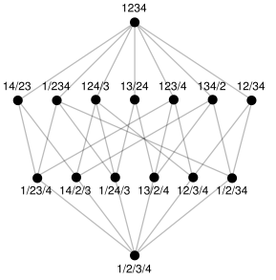
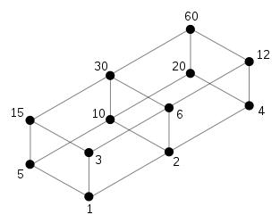
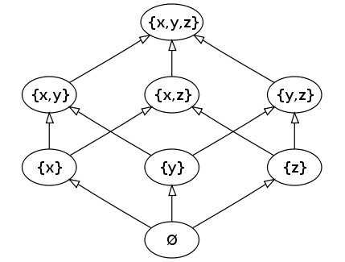
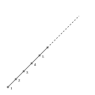
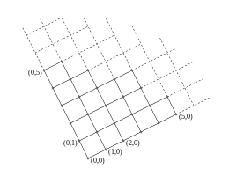
For Your Reference

Slide 16
















Lattice of Snapshots
The set of snapshots of a computation has the lattice structure [Mattern@WPDA’89]
The key notion in modeling global state evolution
P⁽²⁾
CGSs
$$C_{1}$$
$$C_{2}$$
$$C_{3}$$
$$\text{s}\text{(2)}\text{4}$$
The
precede
relation
s⁽¹⁾₀
s⁽¹⁾₁
s⁽¹⁾₂
s⁽¹⁾₃
s⁽¹⁾₄
$$C_{3}$$
P⁽¹⁾
$$\text{s}\text{(2)}\text{3}$$
$$C_{2}$$
$$\text{s}\text{(2)}\text{2}$$
$$C_{1}$$
P⁽²⁾
$$\text{s}\text{(2)}\text{1}$$
s⁽²⁾₀
s⁽²⁾₁
s⁽²⁾₂
s⁽²⁾₃
s⁽²⁾₄
time
$$\text{s}\text{(2)}\text{0}$$
$$\text{s}\text{(1)}\text{0}$$
$$\text{s}\text{(1)}\text{1}$$
$$\text{s}\text{(1)}\text{2}$$
$$\text{s}\text{(1)}\text{3}$$
$$\text{s}\text{(1)}\text{4}$$
P⁽¹⁾
Notes:
Focus on global snapshot, the snapshot is natural. Their relation is natural.

Slide 17















Lattice as a Poset
$L=<C_{S},⇝>$ is a lattice, iff
${∀C_{1},C}_{2}∈C_{S},inf\left({C_{1},C}_{2}\right)∈C_{S }⋀ sup⁡({C_{1},C}_{2})∈C_{S}$
[Gratzer’03]
P⁽²⁾
$$C_{1}$$
$$\text{s}\text{(2)}\text{4}$$
$$sup⁡({C_{1},C}_{2})$$
$$\text{s}\text{(2)}\text{3}$$
$$\text{s}\text{(2)}\text{2}$$
$$inf⁡({C_{1},C}_{2})$$
$$\text{s}\text{(2)}\text{1}$$
$$C_{2}$$
$$\text{s}\text{(2)}\text{0}$$
$$\text{s}\text{(1)}\text{0}$$
$$\text{s}\text{(1)}\text{1}$$
$$\text{s}\text{(1)}\text{2}$$
$$\text{s}\text{(1)}\text{3}$$
$$\text{s}\text{(1)}\text{4}$$
P⁽¹⁾

Slide 18











Sublattice
Definition of sublattice [Gratzer’03]
A subset $S⊆L$ is a sublattice of lattice $L$, iff
$S≠∅, ∀x,y∈S, (x⊓y∈S)⋀(x⊔y∈S)$
P⁽²⁾
$$\text{s}\text{(2)}\text{4}$$
$$\text{s}\text{(2)}\text{3}$$
$$\text{s}\text{(2)}\text{2}$$
$$\text{s}\text{(2)}\text{1}$$
$$\text{s}\text{(2)}\text{0}$$
$$\text{s}\text{(1)}\text{0}$$
$$\text{s}\text{(1)}\text{1}$$
$$\text{s}\text{(1)}\text{2}$$
$$\text{s}\text{(1)}\text{3}$$
$$\text{s}\text{(1)}\text{4}$$
P⁽¹⁾

Slide 19


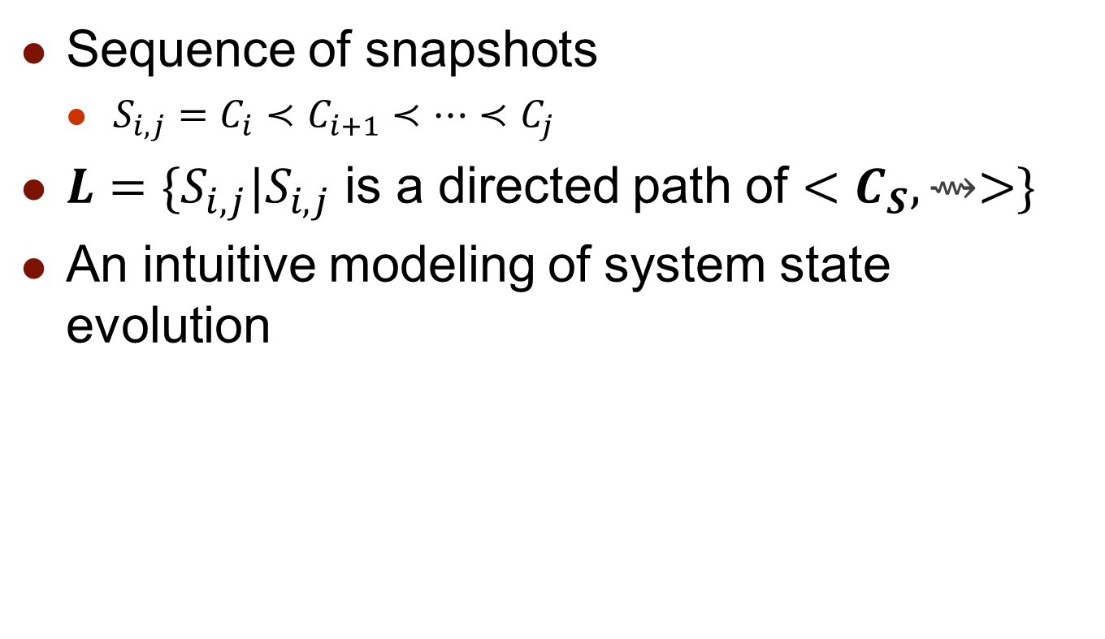








Lattice as All Possible Evolutions of System State
Sequence of snapshots
${S_{i,j}=C}_{i}≺C_{i+1}≺…≺C_{j}$
$L=\{S_{i,j}|S_{i,j}$ is a directed path of $<C_{S},⇝>\}$
An intuitive modeling of system state evolution
[Genon@FM’06]
P⁽²⁾
$$\text{s}\text{(2)}\text{4}$$
$$\text{s}\text{(2)}\text{3}$$
$$\text{s}\text{(2)}\text{2}$$
$$\text{s}\text{(2)}\text{1}$$
$$\text{s}\text{(2)}\text{0}$$
$$\text{s}\text{(1)}\text{0}$$
$$\text{s}\text{(1)}\text{1}$$
$$\text{s}\text{(1)}\text{2}$$
$$\text{s}\text{(1)}\text{3}$$
$$\text{s}\text{(1)}\text{4}$$
P⁽¹⁾
Notes:
Note: S_{i,j} is a directed path but not a total order of CGSs.

Slide 20











Lattice as a DAG
Poset $→$ Hasse diagram
Facilitating algorithms of lattice construction and traversal [Cooper@WPDD’91, Habib@TCS’96, Garg@PDCS’03, Alagar@TSE’01, Nourine@IPL’99, Hua@UIC’10]
P⁽²⁾
$$\text{s}\text{(2)}\text{4}$$
$$\text{s}\text{(2)}\text{3}$$
$$\text{s}\text{(2)}\text{2}$$
$$\text{s}\text{(2)}\text{1}$$
$$\text{s}\text{(2)}\text{0}$$
$$\text{s}\text{(1)}\text{0}$$
$$\text{s}\text{(1)}\text{1}$$
$$\text{s}\text{(1)}\text{2}$$
$$\text{s}\text{(1)}\text{3}$$
$$\text{s}\text{(1)}\text{4}$$
P⁽¹⁾
Notes:
Adopt data structures and algorithms of graph theory

Slide 21
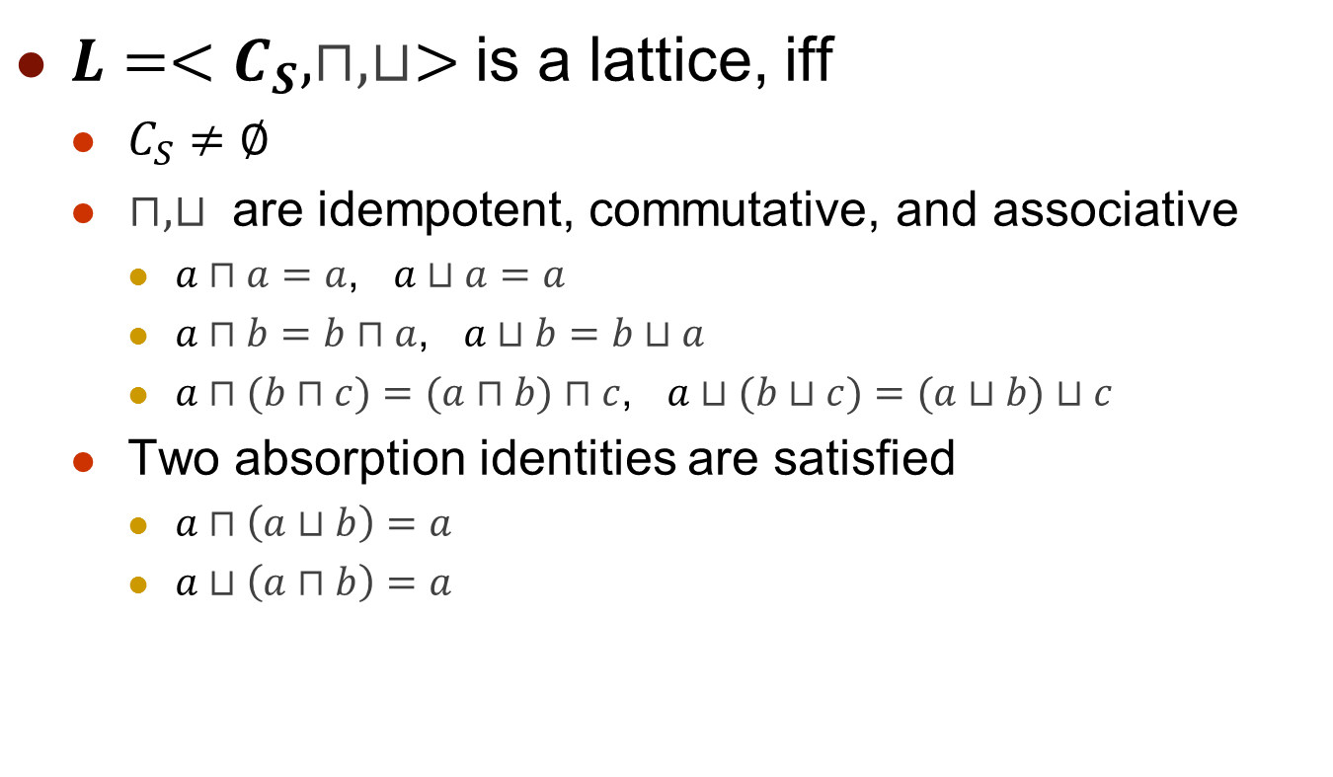
Lattice as an Algebraic Structure
$L=<C_{S}, ⊓,⊔>$ is a lattice, iff
$C_{S}≠∅$
$⊓,⊔$ are idempotent, commutative, and associative
$a⊓a=a$, $a⊔a=a$
$a⊓b=b⊓a$, $a⊔b=b⊔a$
$a⊓(b⊓c)=(a⊓b)⊓c$, $a⊔(b⊔c)=(a⊔b)⊔c$
Two absorption identities are satisfied
$a⊓\left(a⊔b\right)=a$
$a⊔\left(a⊓b\right)=a$
[Schwarz@DC’94, Gratzer’11]

Slide 22
Modeling of System Behavior
Space-time diagram (STD)
Meaningful snapshots of a distributed system
Lattice of snapshots
Lattice as a partial order set
Lattice as all possible evolutions of system state
Lattice as a directed acyclic graph
Lattice as an algebraic structure of snapshots
Relation between the STD and the lattice
Birkhoff’s representation theorem

Slide 23


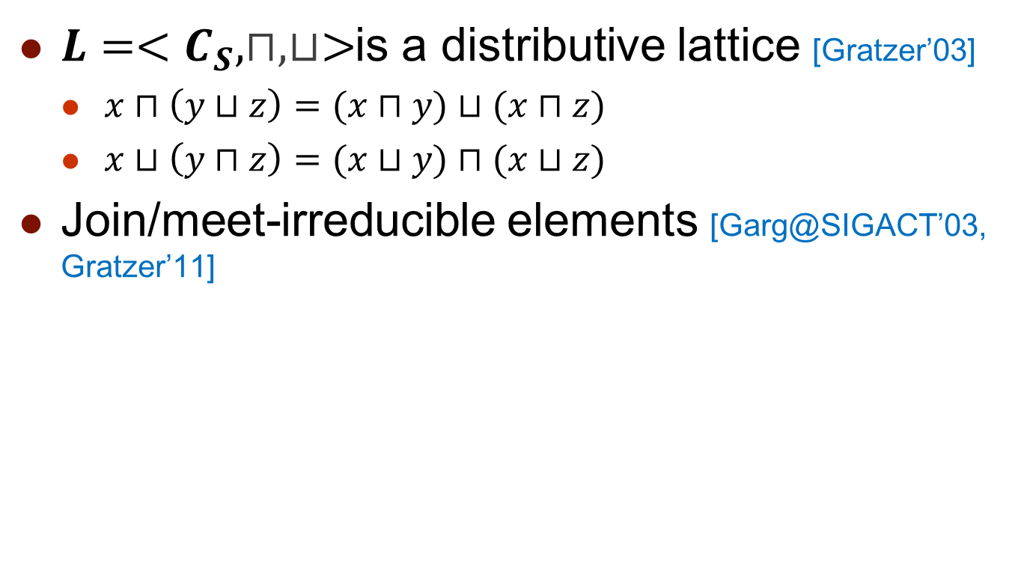








Distributive Lattice
$L=<C_{S}, ⊓,⊔>$is a distributive lattice [Gratzer’03]
$x⊓\left(y⊔z\right)=(x⊓y)⊔(x⊓z)$
$x⊔\left(y⊓z\right)=(x⊔y)⊓(x⊔z)$
Join/meet-irreducible elements [Garg@SIGACT’03, Gratzer’11]
P⁽²⁾
Join-irreducible
$$\text{s}\text{(2)}\text{4}$$
Meet-irreducible
$$\text{s}\text{(2)}\text{3}$$
$$\text{s}\text{(2)}\text{2}$$
$$\text{s}\text{(2)}\text{1}$$
$$\text{s}\text{(2)}\text{0}$$
$$\text{s}\text{(1)}\text{0}$$
$$\text{s}\text{(1)}\text{1}$$
$$\text{s}\text{(1)}\text{2}$$
$$\text{s}\text{(1)}\text{3}$$
$$\text{s}\text{(1)}\text{4}$$
P⁽¹⁾

Slide 24
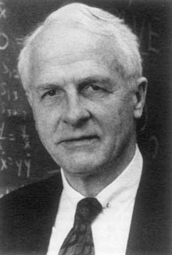














Birkhoff’s Representation Theorem
Isomorphism [Birkhoff@DMJ’37, Davey’90, Gratzer’11]
$L≅Down(JI(L))$
$P≅JI(Down(P))$
P⁽²⁾
$$L$$
$$Down(JI(L))$$
$$JI(L)$$
$$\text{s}\text{(2)}\text{4}$$
$$\text{s}\text{(2)}\text{3}$$
$$\text{s}\text{(2)}\text{2}$$
Garrett Birkhoff
$$\text{s}\text{(2)}\text{1}$$
$$\text{s}\text{(2)}\text{0}$$
$$\text{s}\text{(1)}\text{0}$$
$$\text{s}\text{(1)}\text{1}$$
$$\text{s}\text{(1)}\text{2}$$
$$\text{s}\text{(1)}\text{3}$$
$$\text{s}\text{(1)}\text{4}$$
P⁽¹⁾
[Birkhoff@DMJ’37] Rings of sets, Duke Mathematical Journal 3 (3): 443–454.

Slide 25













Birkhoff’s Representation Theorem
Isomorphism [Birkhoff@DMJ’37, Davey’90, Gratzer’11]
$L≅Down(JI(L))$
$P≅JI(Down(P))$
$$P$$
P⁽²⁾
$$Down(P)$$
$$JI(Down(P))$$
s⁽¹⁾₀
s⁽¹⁾₁
s⁽¹⁾₂
s⁽¹⁾₃
s⁽¹⁾₄
$$\text{s}\text{(2)}\text{4}$$
P⁽¹⁾
$$\text{s}\text{(2)}\text{3}$$
P⁽²⁾
$$\text{s}\text{(2)}\text{2}$$
P⁽²⁾
$$\text{s}\text{(2)}\text{1}$$
P⁽¹⁾
s⁽²⁾₀
s⁽²⁾₂
s⁽²⁾₃
s⁽²⁾₁
s⁽²⁾₄
time
$$\text{s}\text{(2)}\text{0}$$
$$\text{s}\text{(1)}\text{0}$$
$$\text{s}\text{(1)}\text{1}$$
$$\text{s}\text{(1)}\text{2}$$
$$\text{s}\text{(1)}\text{3}$$
$$\text{s}\text{(1)}\text{4}$$
P⁽¹⁾

Slide 26
Specification of Predicates
Syntax and semantics of predicate specification
Characterizing predicates by their detection properties
Characterizing the space of predicates
Notes:
内在的定义语法语义
规约和检测不可分，有一类谓词检测时表现出一些特性，对于其的检测有特殊的方法
介绍谓词之间的关系，刻画谓词集合的空间

Slide 27
Syntax and Semantics
Specification on STD
Local predicates
Linked predicates
Specification on Lattice
Snapshot predicates
Sequence predicates
Regular expression predicates
Temporal logic predicates
[Babaoglu@JSS’96]

Slide 28
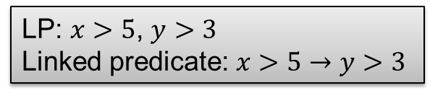
Specification on STD
Local predicates (LP)
Linked predicates [Miller@ICDCS’88, Garg@FSTTCS’92, @TPDS’96]
LP: $x>5$, $y>3$
Linked predicate: $x>5→y>3$
Linked predicates
s⁽¹⁾₀
s⁽¹⁾₁
s⁽¹⁾₂
s⁽¹⁾₃
s⁽¹⁾₄
x
P⁽¹⁾
…
6
2
4
2
3
LP
LP
LP
1
3
4
3
1
y
P⁽²⁾
s⁽²⁾₀
s⁽²⁾₁
s⁽²⁾₂
s⁽²⁾₃
s⁽²⁾₄
time

Slide 29

Specification on STD
Local predicates (LP)
Linked predicates [Miller@ICDCS’88, Garg@FSTTCS’92, @TPDS’96]
LP: $x>5$, $y>3$
Linked predicate: $x>5→y>3$
e⁽¹⁾₁
e⁽²⁾₁
e⁽¹⁾₂
e⁽²⁾₂
e⁽¹⁾₃
e⁽²⁾₃
e⁽¹⁾₄
e⁽²⁾₄
Modality
e⁽¹⁾₁
e⁽²⁾₁
e⁽²⁾₂
e⁽¹⁾₂
e⁽²⁾₃
e⁽¹⁾₃
e⁽¹⁾₄
e⁽²⁾₄
Linked predicates
e⁽¹⁾₁
e⁽¹⁾₂
e⁽¹⁾₃
e⁽¹⁾₄
LP
P⁽¹⁾
x
6
2
4
2
3
LP
P⁽²⁾
y
1
e⁽²⁾₁
3
e⁽²⁾₂
4
e⁽²⁾₃
3
e⁽²⁾₄
1
time
Notes:
Linked predicate in [Garg@FSTTCS’92] is for both pos and def. [Garg@TPDS’96] is only for def.
[Babaoglu@JSS’96] is for control flow predicates but not for linked predicates, which is defined on directed path in STD, but not linear extensions.
Pos linked predicates are detected by def linked predicates and weak conjunctive predicates. [Garg@FSTTCS’92]

Slide 30
Specification on Lattice
Snapshot predicates
Conjunctive predicates [Garg@TPDS’94, TPDS’96, Huang@PerCom’09, TPDS’12]
Relational predicates [Tomlinson@JPDC’97]
Sequence predicates
Regular expression predicates [Babaoglu@JPDC’95, JSS’96, Huang@ICPADS’10, Hurfin@WPDD’93, Fromentin@ICPP’94, Jard@ICDCS’94]
Temporal logic predicates [Garg@ICDCS’01, Sen@TC’07, Mittal@TPDS’07, Genon@FM’06, Kalyon@FORTE’07, Massart@IPL’08]
Notes:
LTL and CTL

Slide 31











Specification on Lattice
Snapshot predicates: $x+y>5$ , $x+y≤8$
Sequence predicate: $(x+y>5)⇝(x+y≤8)$
y
P⁽²⁾
Modality
1
$$\text{s}\text{(2)}\text{4}$$
Snapshot
predicate
3
$$\text{s}\text{(2)}\text{3}$$
Sequence
predicates
4
$$\text{s}\text{(2)}\text{2}$$
3
$$\text{s}\text{(2)}\text{1}$$
1
$$\text{s}\text{(2)}\text{0}$$
$$\text{s}\text{(1)}\text{0}$$
$$\text{s}\text{(1)}\text{1}$$
$$\text{s}\text{(1)}\text{2}$$
$$\text{s}\text{(1)}\text{3}$$
$$\text{s}\text{(1)}\text{4}$$
P⁽¹⁾
6
2
4
2
3
x
Notes:
Modalities include EG, AG, EF, and AF (controllable, invariant, possibly, and definitely, respectively) [Garg’02]
[Hurfin@PDCS’96]

Slide 32
Specification on Lattice
Modality
Sequence predicates
Snapshot predicate
Snapshot predicate
…
Snapshot predicate
LP
LP
…
LP
LP
LP
…
LP
LP
LP
…
LP

